Slide 1

ICE 3161
COMMUNICATION ENGINEERING
Dr. Asif Zaman
Professor, CSE, RU

Slide 2
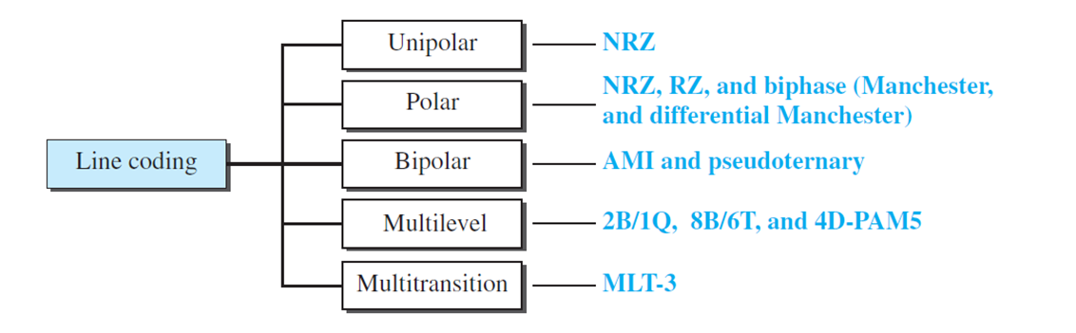
Digital-to-digital Conversion
The conversion involves three techniques:
  line coding,
  block coding, and
  scrambling.

Slide 3
Bipolar Schemes
In bipolar encoding (sometimes called multilevel binary), there are three voltage levels:
  positive,
  negative, and
  zero.
The voltage level for one data element is at zero, while the voltage level for the other element alternates between positive and negative.
Two Scheme:
  AMI and
  Pseudoternary

Slide 4
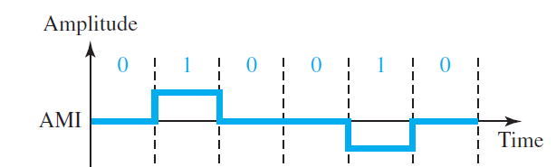
Bipolar Schemes: AMI
Alternate Mark Inversion (AMI).
A neutral zero voltage represents binary 0
Binary 1s are represented by alternating positive and negative voltages

Slide 5
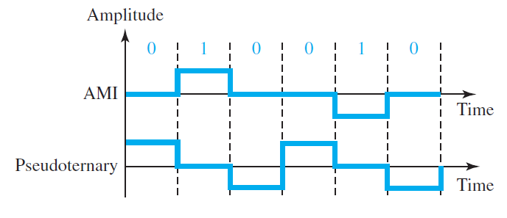
Bipolar Schemes: Pseudoternary
A variation of AMI encoding is called pseudoternary in which
The 1 bit is encoded as a zero voltage and
the 0 bit is encoded as alternating positive and negative voltages

Slide 6
Multilevel Schemes
mBnL
  where m is the length of the binary pattern,
  B means binary data,
  n is the length of the signal pattern, and
  L is the number of levels in the signaling.
    A letter is often used in place of L:
    B(binary) for L = 2,
    T (ternary) for L = 3, and
    Q (quaternary) for L = 4.
2B1Q
8B6T

Slide 7
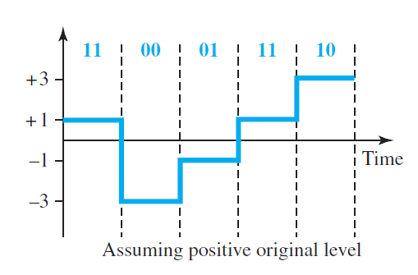

Multilevel: 2B1Q scheme

Slide 8
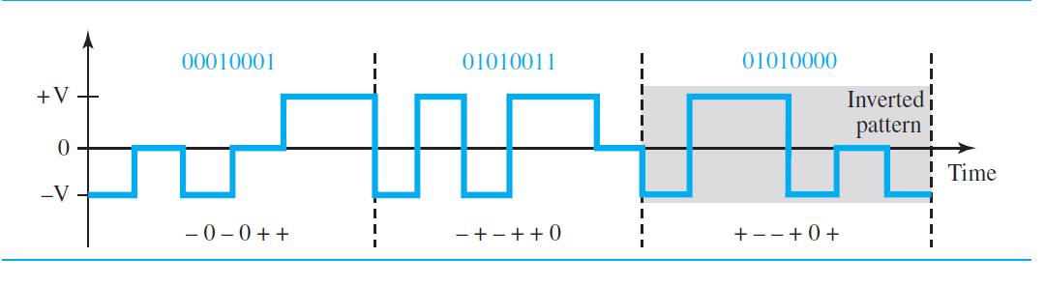
Multilevel: 8B6T scheme
01010000 should be encoded as + − − + 0 + with weight +1
− 0 − 0 + + with weight 0
− + − + + 0 with weight +1
In this type of scheme, we can have
  2^8 = 256 different data patterns and
  3^6 = 729 different signal patterns.
There are 729 − 256 = 473 redundant signal elements that provide synchronization and error detection.

Slide 9
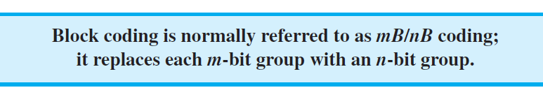
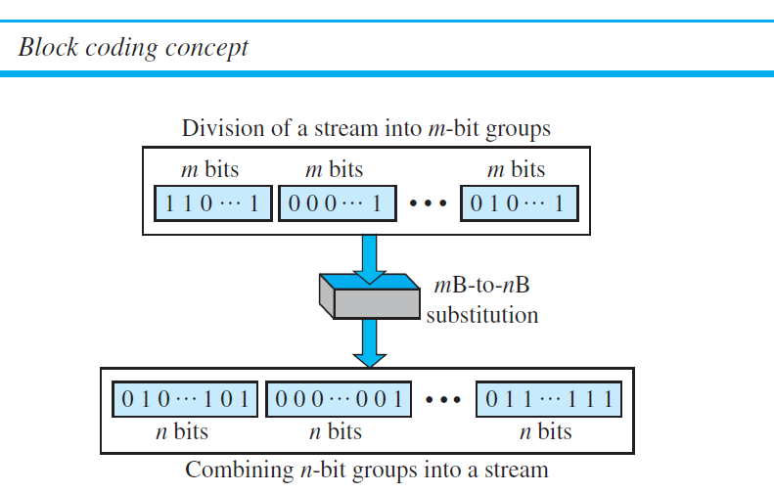
Block Coding
Block coding changes a block of m bits into a block of n bits, where n is larger than m.
Block coding is referred to as an mB/nB encoding technique.

Slide 10
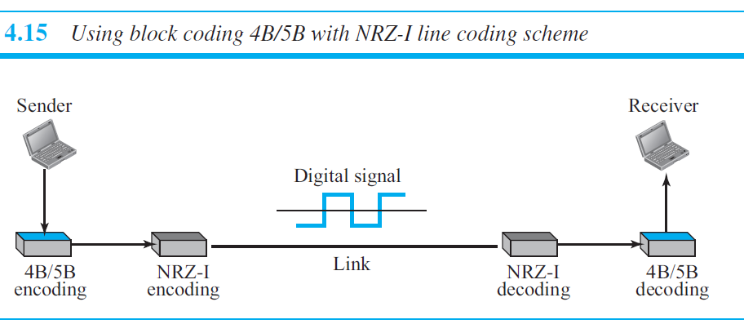

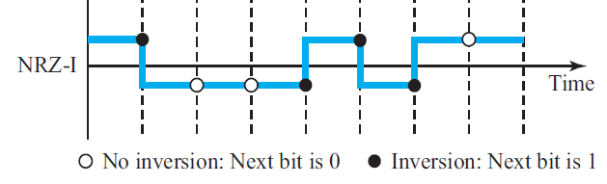
Four binary/five binary (4B/5B)

Slide 11
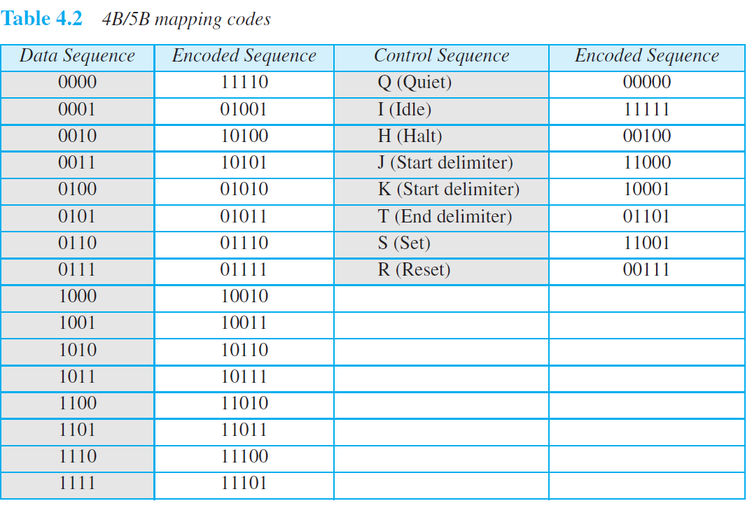
Four binary/five binary (4B/5B)
In 4B/5B, …no more than one leading zero (left bit) and no more than two trailing zeros (right bits).

Slide 12
Scrambling
We are looking for a technique that does not increase the number of bits and does provide synchronization.
We are looking for a solution that substitutes long zero-level pulses with a combination of other levels to provide synchronization.
One solution is called scrambling.
Two common scrambling techniques are B8ZS and HDB3.

Slide 13
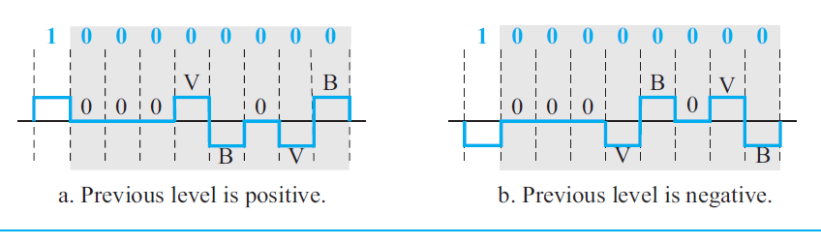

Scrambling: B8ZS
Bipolar with 8-zero substitution (B8ZS)
The V in the sequence denotes violation; this is a nonzero voltage that breaks an AMI rule of encoding (opposite polarity from the previous).
The B in the sequence denotes bipolar, which means a nonzero level voltage in accordance with the AMI rule.

Slide 14
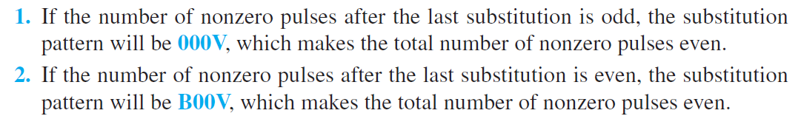
Scrambling: HDB3
High-density bipolar 3-zero (HDB3) is commonly used outside of North America.
Four consecutive zero-level voltages are replaced with a sequence of 000V or B00V.
The reason for two different substitutions is to maintain the even number of nonzero pulses after each substitution

Slide 15
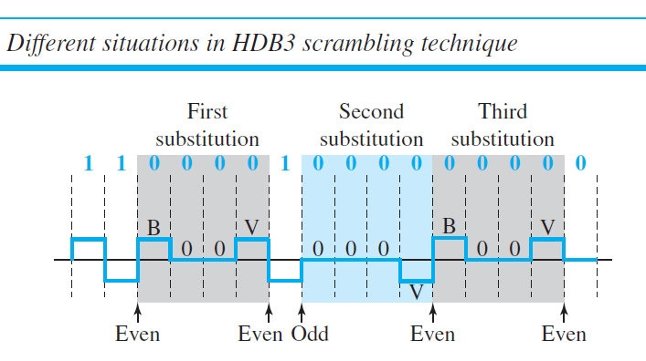
Scrambling: HDB3
Non-Zero Pulse: EVEN

